Slide 1
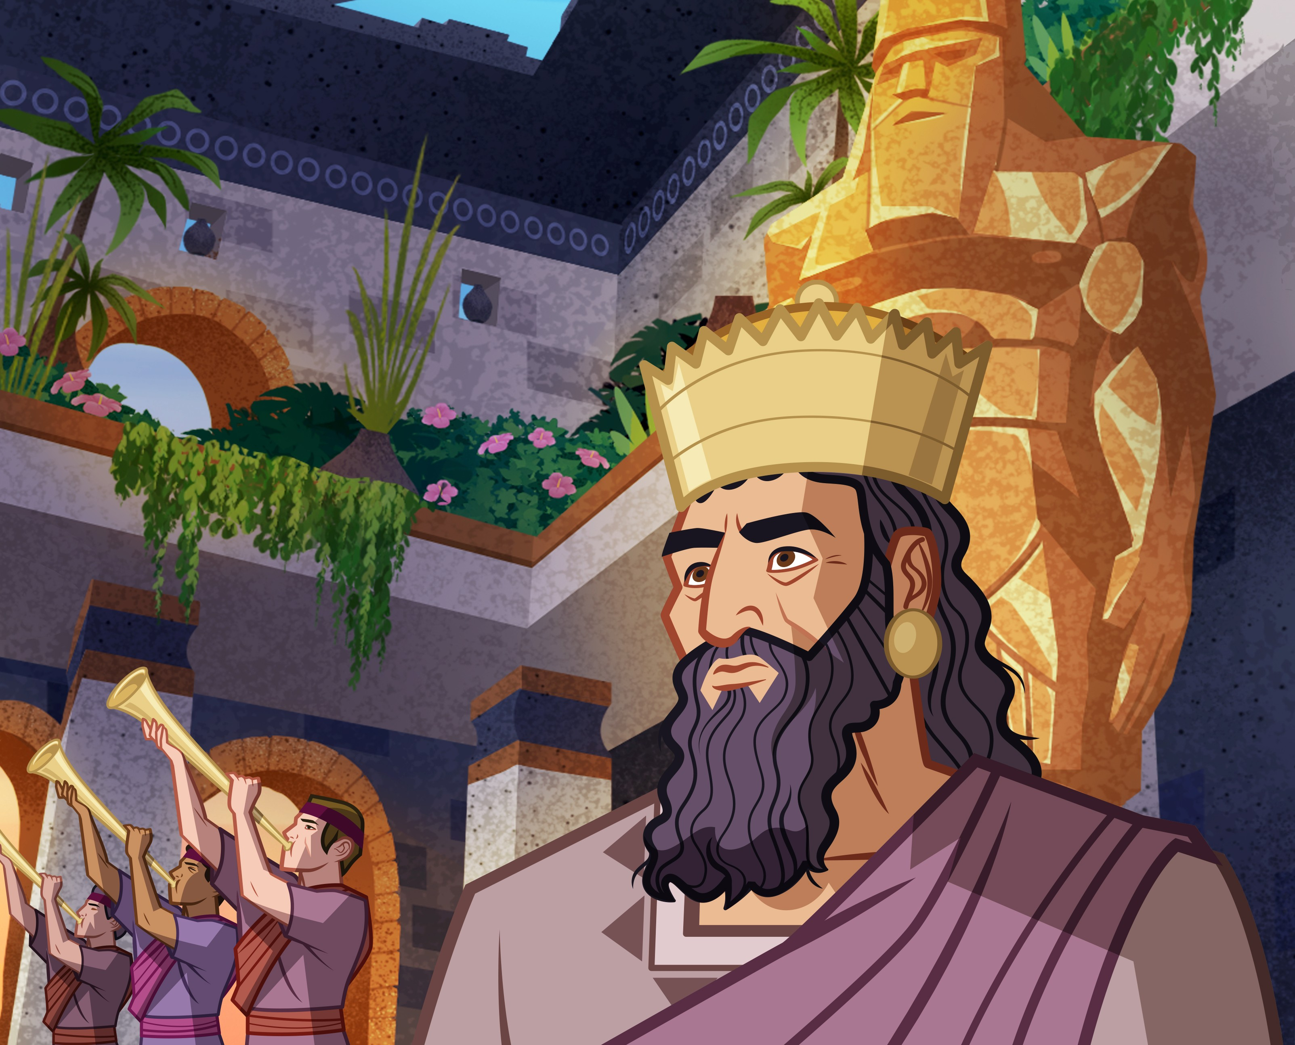

Slide 2
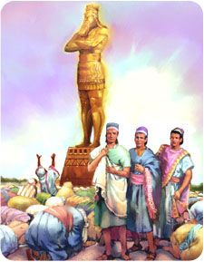

Slide 3
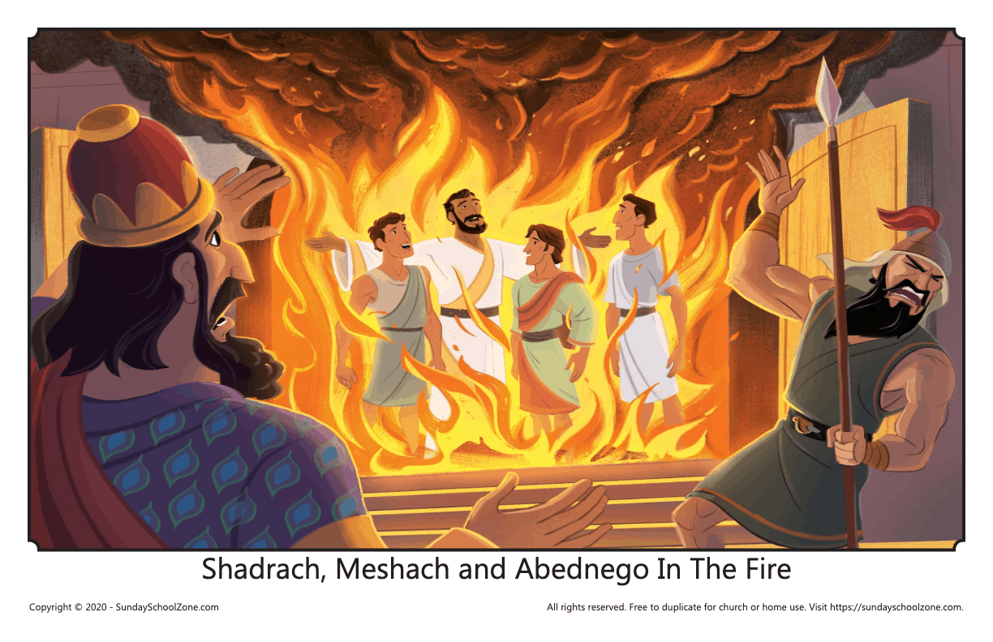

Slide 4
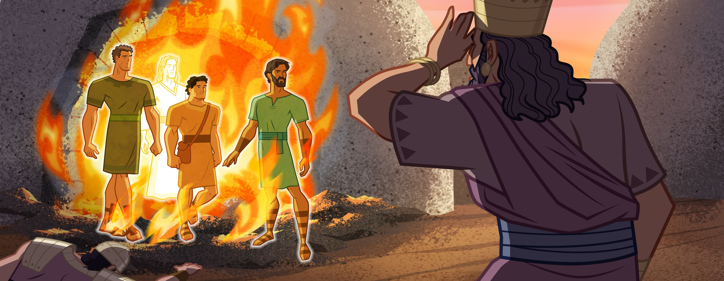

Slide 5
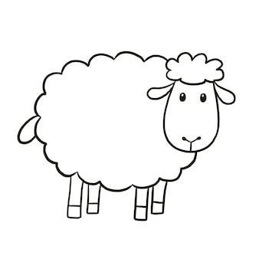
DAUD
DAUD
DAUD
DAUD
DAUD
DAUD

Slide 6

YOSUA
YOSUA
YOSUA
YOSUA
YOSUA
YOSUA

Slide 7

ESTER
ESTER
ESTER
ESTER
ESTER
ESTER

Slide 8
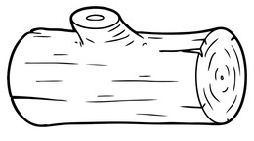
YUSUF
YUSUF
YUSUF
YUSUF
YUSUF
YUSUF

Slide 9

SAMUEL
SAMUEL
SAMUEL
SAMUEL
SAMUEL
SAMUEL

Slide 10
SAMUEL
YUSUF
ESTER
YOSUA
DAUD

